Slide 1
Compiler-based Side Channel Vulnerability Analysis and Optimized Countermeasures Application
Giovanni Agosta, Alessandro Barenghi, Massimo Maggi, and Gerardo Pelosi
Dipartimento di Elettronica, Informazione e Bioingegneria – DEIB,
Politecnico di Milano
Published in Design Automation Conference (DAC), 2013 50th ACM/EDAC/IEEE
Presented by Erik Shreve
Notes:
Polytechnic University of Milan (Italy)
EDAC: Electronic Design Automation Consortium
ACM: Association for Computing Machinery

Slide 2
Side Channel Attacks
Definition: An attack using information gleaned from the physical and/or SW implementation of a system rather than from a weakness in the algorithm (math).
Active vs Passive: Active attacks tamper with the device. Passive attacks monitor behavior.
Some of them developers can prevent:
Don’t use memcmp on secret data!
Some are so low level we need analysis:
Like the one done in this paper.
Notes:
Use this as the hook, why should they care.
Side Channels Include:
Timing
Power Analysis
EM Radiation (Some consider this a form of Power Analysis)
Acoustic
Data remanence
Row hammer

Slide 3
Power Analysis Example
Researchers showed ability to recover cryptographic keys from iPhones by monitoring power consumption (via modified charger) while phone performs cryptographic operations.
Equipment cost: ~$100 + Laptop
Daniel Genkin, Lev Pachmanov, Itamar Pipman, Eran Tromer, Yuval Yarom, ECDSA Key Extraction from Mobile Devices via Nonintrusive Physical Side Channels, IACR Cryptology ePrint Archive
Notes:
Summary
We show that modern cryptographic software on mobile phones, implementing the ECDSA digital signature algorithm, may inadvertently expose its secret keys through physical side channels: electromagnetic radiation and power consumption which fluctuate in a way that depends on secret information during the cryptographic computation. An attacker can non-invasively measure these physical effects using a $2 magnetic probe held in proximity to the device, or an improvised USB adapter connected to the phone's USB cable, and a USB sound card. Using such measurements, we were able to fully extract secret signing keys from OpenSSL and CoreBitcoin running on iOS devices. We also showed partial key leakage from OpenSSL running on Android and from iOS's CommonCrypto.
Equipment needed was only a USB sound card, laptop, wires, and a hacked up charger.

Slide 4
Power Analysis Threat Model
Threat Models inform the reader about the assumed capabilities of an attacker.
Notably, this paper is lacking a threat model.
In the power analysis side channel attack, the attacker is assumed to:
Have access to the power consumption of the device being attacked (possibly remotely via EM).
Have some idea of approximately when a cryptographic operation of interest is occurring.
Notes:
Threat model probably missing since paper was limited to 6 pages and it isn’t a security conference.
Power Analysis Attack – Two Techniques:
Simple Power Analysis (SPA) – Just looking at the power traces
Differential Power Analysis (DPA) – Power traces from multiple crypto operations are statistically analyzed to gather info on intermediate results of the cryptographic operation.

Slide 5
Differential Power Analysis Technique
Attacker is trying to determine bits of a value (usually the cryptographic key).
Measurements are taken over n cryptographic operations.
Statistics used to screen out noise.

Slide 6
Differential Power Analysis Technique
Sort traces with ciphertext into two sets using a selection function which is based on ciphertext and a guess of part of the key value.
If guess of partial key value is correct, there will be a larger statistical difference between the two sets of power traces.

Slide 7
Power Analysis Defense
Incorporate fresh randomness into each pass of the algorithm so that statistical differences between power traces can’t be determined.
Random bit values -> random power trace -> don’t need to know the details of the target’s power usage to create the defense.

Slide 8
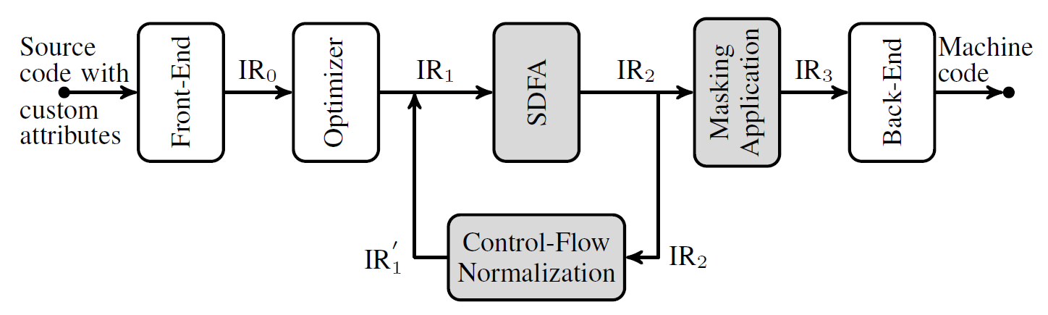
Tool Pipeline
IR₁, IR₂, and IR₃ are in SSA Form
Image taken from paper

Slide 9
Tool Pipeline
Defense added here
IR₁, IR₂, and IR₃ are in SSA Form
Image taken from paper

Slide 10
Tool Pipeline
Where to place defense determined here
IR₁, IR₂, and IR₃ are in SSA Form
Image taken from paper

Slide 11
SSA Form
The Data Flow Analysis is performed on an Intermediate Language in Static Single Assignment Form (SSA).
(Makes Data-Flow Analysis easier)
This | Becomes
Z ← 10 | Z1 ← 10
X ← Z + 5 | X1 ← Z1 + 5
Y ← X – 3 | Y1 ← X1 – 3
X ← Z + 10 | X2 ← Z1 + 10
Y ← Y + 1 | Y2 ← Y1 + 1
Notes:
Definition-Use chains are explicit. Makes dead code analysis easier. Makes constant propagation easier.

Slide 12
Security-oriented Data Flow
stat_{i+1}
i_{in}
stat_{i}
stat_{i+3}
i_{out}
stat_{i+2}
Control-Flow Graph
Each node is a “basic block” and may have multiple instructions.
Notes:
Control-flow graph of statements, augmented with initial and final nodes (iin, iout)

Slide 13
Security-oriented Data Flow
Define a leakage vector V_{I} for each instruction I.
Length is size(I), is the number of bits output by the instruction.
Each entry in V_{I} is itself a vector indicating which key bits are involved in calculating the corresponding bit of the output.
V_{I} | v_{size(I)-1} | v_{t} | v₀
Key bit 0 | 1 | 0 | 0
Key bit 1 | 1 | 1 | 1
Key bit 2 | 0 | 0 | 0

Slide 14
Security-oriented Data Flow
The more ‘1’s in this table the better, as it indicates more key bits were involved in the influence of each output bit.
If the output of I in the table below represented the final ciphertext, this would be a weak crypto algorithm as only one key bit (key bit 1) impacts all output bits.
V_{I} | v_{size(I)-1} | v_{t} | v₀
Key bit 0 | 1 | 0 | 0
Key bit 1 | 1 | 1 | 1
Key bit 2 | 0 | 0 | 0

Slide 15
Security-oriented Data Flow
For every instruction, rules are provided on how the leakage vectors associated with the instruction’s inputs are transformed into a leakage vector for the instruction’s output.

Slide 16
Security-oriented Data Flow
Example for a Multiply instruction:
V_{J1} | v₁ | v₀
K0 | 0 | 0
K1 | 1 | 0
V_{J2} | v₁ | v₀
K0 | 0 | 1
K1 | 0 | 0
MUL
V’_{J1} | v₁ | v₀
K0 | 0 | 0
K1 | 1 | 0
V_{I} | v₁ | v₀
K0 | 1 | 0
K1 | 1 | 1
V’_{J2} | v₁ | v₀
K0 | 1 | 1
K1 | 0 | 0
Notes:
Note that a Load instruction follows same rules. This is because the value loaded entirely depends on the address which is defined by each bit.

Slide 17
Security-oriented Data Flow
A Local SDFA is performed first for each basic block in the CFG. This follows from the material already presented.
A Global SDFA is then created by handling the cases were an instruction has multiple predecessors.
stat_{i+1}
stat_{i+3}
i_{out}
stat_{i+2}

Slide 18
Security-oriented Data Flow
The possible leakage vector inputs for an instruction with multiple predecessors is taken as the “meet” or bitwise-and of the possible leakage vectors from all predecessors.
Except, if one of the predecessor’s leakage vector is null. Then, the input is taken as null.
Thus, a bit of the input of an instruction is protected by a key-bit iff it is protected in all predecessors.

Slide 19
Backward SDFA
CFG is processed from ciphertext output backward to determine where the final round key material is stored.
AES expands the original key into many keys, and then processes data in rounds. Each round uses a different key.
The final round key material is then treated as the key bits in the leakage vectors.
Since the original key is expanded in deterministic manner, it is important to protect operations depending on the final round key.

Slide 20
Instruction Analysis
Now each instruction has an output leakage vector, V_{I}.
They define resistance as the minimum hamming weight (number of key bits) of an instruction’s V_{I}, or as infinity if no bits of the key are involved.
Higher hamming weights are better.
Resistance is cumulative as it depends on the instruction’s input which is the output of the preceding instruction(s).

Slide 21
Mitigation Insertion
For their experimental evaluation, they chose to insert mitigations on any instruction with a resistance less than 80 (max resistance is 128).
In other words, if fewer than 80 bits of the 128-bit key are used in the computation of any of the output bits of an instruction, that instruction has the mitigation applied.

Slide 22
Mitigation Insertion
Vulnerable operations have their inputs split by XOR’ing d-random values with whatever value (x₀) is needed to obtain the original input.
x₀ xor x₁ xor … x_{d} = x
The operation is then performed on each x_{i} and results combined to get same result as original algorithm.
Notes:
Related to Multi Part Communication and Homomorphic Encryption. Yvo Desmedt is an expert in this area.

Slide 23
Conclusion
Authors were able to use static DFA to optimize the placement of side channel mitigations.
Optimization of mitigation placement resulted in an overall performance improvement of ~2.5x compared to previously published results.
Authors’ method is language and target agnostic. However, it does require access to source code to label key material.

Slide 24
Discussion Questions
They applied their Security-oriented Data Flow Analysis after the optimization stage of the compiler. Why?
What pros/cons would there be in performing SDFA and mitigation insertion on binary code?
Has this paper changed your view on how secret data should be handled? How?
Notes:
Optimization will remove unused paths that then don’t need to be analyzed.
Also, optimization changes may change the detail flow and thus could nullify the mitigations if placed in the system after.
Pros:
SDFA on binary would allow purchased binaries to be protected without access to source code (licensing issues).
Solution becomes compiler agnostic.
Tools like BAP can be used to remain target agnostic.
Cons:
Data-flow analysis is harder.
Identifying key material is harder.

Slide 25
Backup Slides

Slide 26
Discussion Questions
There were no statistics in this paper (other than a simple execution speed analysis of the protected binary). Why do you think that is?
Would a dynamic analysis instead of static analysis allow them to improve their optimization of mitigation placement?
Notes:
No statistics in part because security papers tend to aim for absolutes – we protected this under the following assumptions rather than we protected x% attacks.
Dynamic analysis would not help as they need to protect for all possible values flowing through the algorithm.

Slide 27
Security-oriented Data Flow
Example for an XOR:
V_{J1} | v₁ | v₀
K0 | 0 | 0
K1 | 1 | 0
V_{J2} | v₁ | v₀
K0 | 0 | 1
K1 | 0 | 0
XOR
V_{I} | v₁ | v₀
K0 | 0 | 1
K1 | 1 | 0
Just OR each bit of the V_{J} vectors to form the output
Notes:
Just or each bit of the Vj vectors to form the output

Slide 28
Security-oriented Data Flow
Example for a Bitwise or with immediate operand (2d):
V_{J1} | v₁ | v₀
K0 | 1 | 0
K1 | 1 | 1
V_{imm} | v₁ | v₀
K0 | 1 | 1
K1 | 0 | 0
OR
Vector is bitwise not of immediate value
V_{I} | v₁ | v₀
K0 | 1 | 0
K1 | 0 | 0
Unlike many other rules, a join or bitwise and is done here:
Notes:
In this example, or’ing with 2d (10b) means that the msb no longer depends on the other input. Thus, the key protection of that bit should not propagate forward.
For an and, Vimm is the immediate operand (so 10b for 2d) instead of the bitwise not. The rest is the same (perform an join).

Slide 29
Security-oriented Data Flow
Example for a Shift Left with by Immediate:
V_{J1} | v₁ | v₀
K0 | 1 | 0
K1 | 0 | 1
1
SHL
V_{I} | v₁ | v₀
K0 | 0 | 0
K1 | 1 | 0
Just shift the little v’s,
fill in with bottom (all zeros)

Slide 30
Loop Peeling
As part of the Control Flow Normalization (done during Global SDFA), “Loop Peeling” is performed.
If the confluence of multiple predecessors into the beginning of a loop results in information loss (that is, the system conservatively drops the involvement of key bits not used in each predecessor), the first iteration is peeled from the loop into its own basic block.
By doing this, it is possible that the confluence of the loop will result in no information loss, reducing the odds that it will need mitigation inserted.

Slide 31
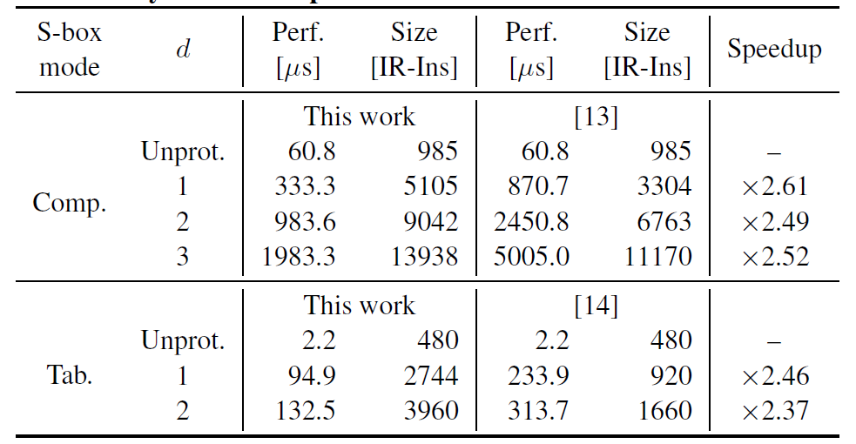
Performance Results
Performance and code size of AES-128 algorithm with both computational and tabulated S-boxes as a function of the employed masks, d. All the instructions with resistance lower than 80 are masked.
Image and text from paper

Slide 32
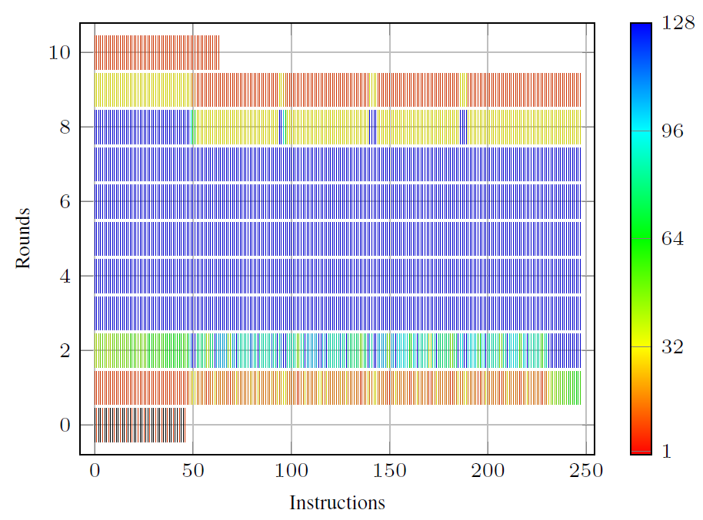
Resistance Diagram
Resistance of sensitive instructions of the AES-128 encryption primitive (ShiftRow, SubBytes as a tabulated S-box, computational MixColumn, AddRoundKey) in number of key bits protecting the weakest bit of the corresponding outcome. The Key-schedule part is not shown as its instructions are not sensitive.
Image and text from paper

